Slide 1


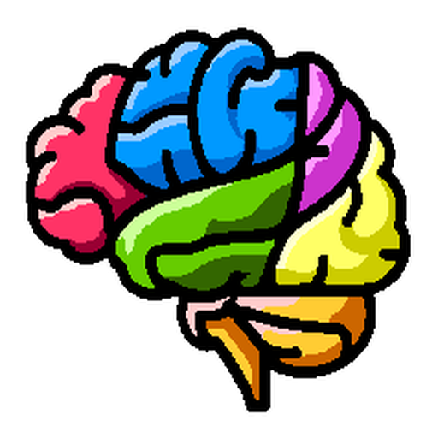
NiChart: Neuro Imaging Chart of AI-based Imaging Biomarkers
Organization for Human Brain Mapping (OHBM) 2024
Notes:
ADD PENNSIVE LOGO

Slide 2
Process multi-modal MRI images
Harmonize to reference data
Apply ML models
Derive individualized biomarkers
“NiChart is a suite of modular yet integrated software tools for neuroimaging research, along with a cloud-based web application that offers broad access to these tools.”

Slide 3
NiChart Software Components
Image Processing
Data Harmonization
Machine Learning
Fast Segmentation of Anatomy and Abnormality
(DLICV)
Multi-Resolution Structural Covariance Patterns
(sopNMF)
End-to-end Processing Pipelines for fMRI and DTI Analysis
(fMRIPrep)
(DLMUSE)
(DLWMLS)
(XCP-D)
(DTIPrep)
(pNet)
Supervised ML models for age and disease prediction:
SPARE-AD
SPARE-BA
SPARE-CVD
Semi-supervised ML models for disease subtype analysis:
SmileGAN
SurrealGAN
Deep learning models for biomarker extraction from raw images:
DLSPARE

Slide 4
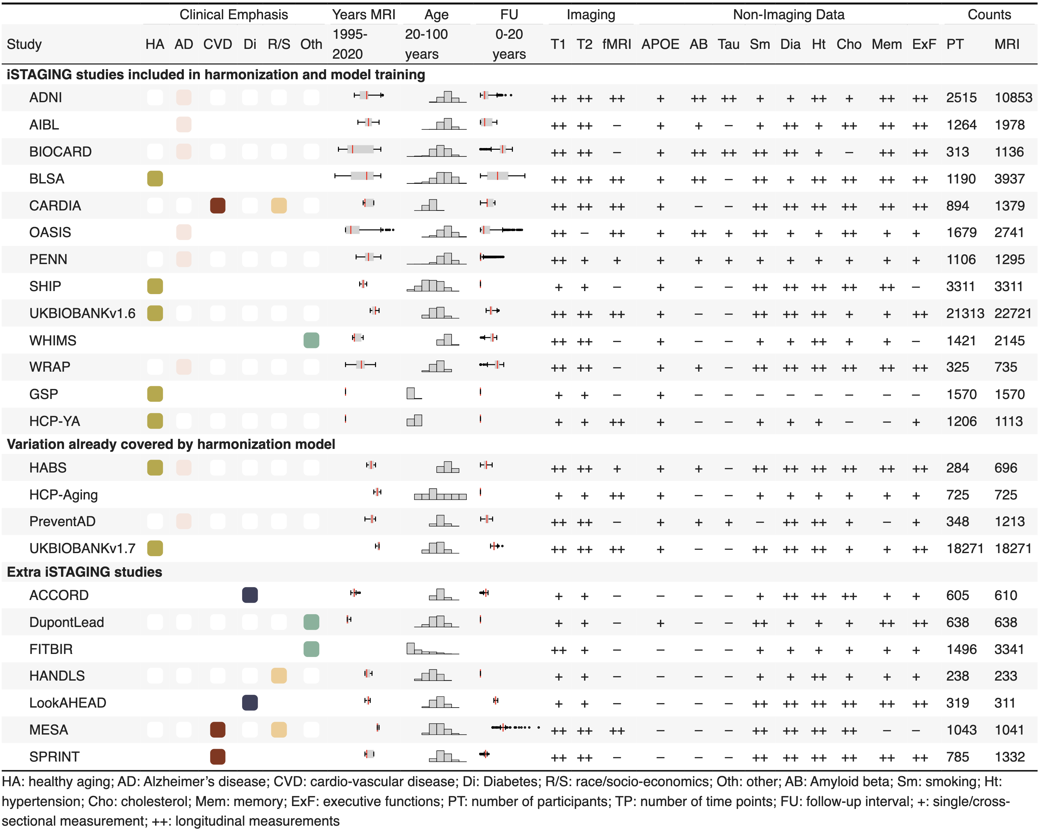
Reference Data Curation
ISTAGING Dataset:
Large and diverse dataset with over 70,000 multi-modal MRI time points across 23 studies.
Rich, curated clinical-cognitive data for disease characterization.
Trained pipelines for extracting imaging features.
Used for harmonization.
Created models for deriving biomarkers.
Normative ranges for visualizations.

Slide 5
Image Processing
Deep Learning for fast segmentation of anatomy and abnormality for sMRI:
DLICV
DLMUSE
DLWMLS
Multi-resolution structural covariance patterns:
sopNMF
End-to-end processing pipelines for fMRI and DTI analysis:
fMRIPrep
XCP-D
DTIPrep
pNet

Slide 6
Data Harmonization

Slide 7
Machine Learning
Supervised ML models for age and disease prediction:
SPARE-AD
SPARE-BA
SPARE-CVD
Semi-supervised ML models for disease subtype analysis:
SmileGAN
SurrealGAN
Deep learning models for biomarker extraction from raw images:
DLSPARE

Slide 8
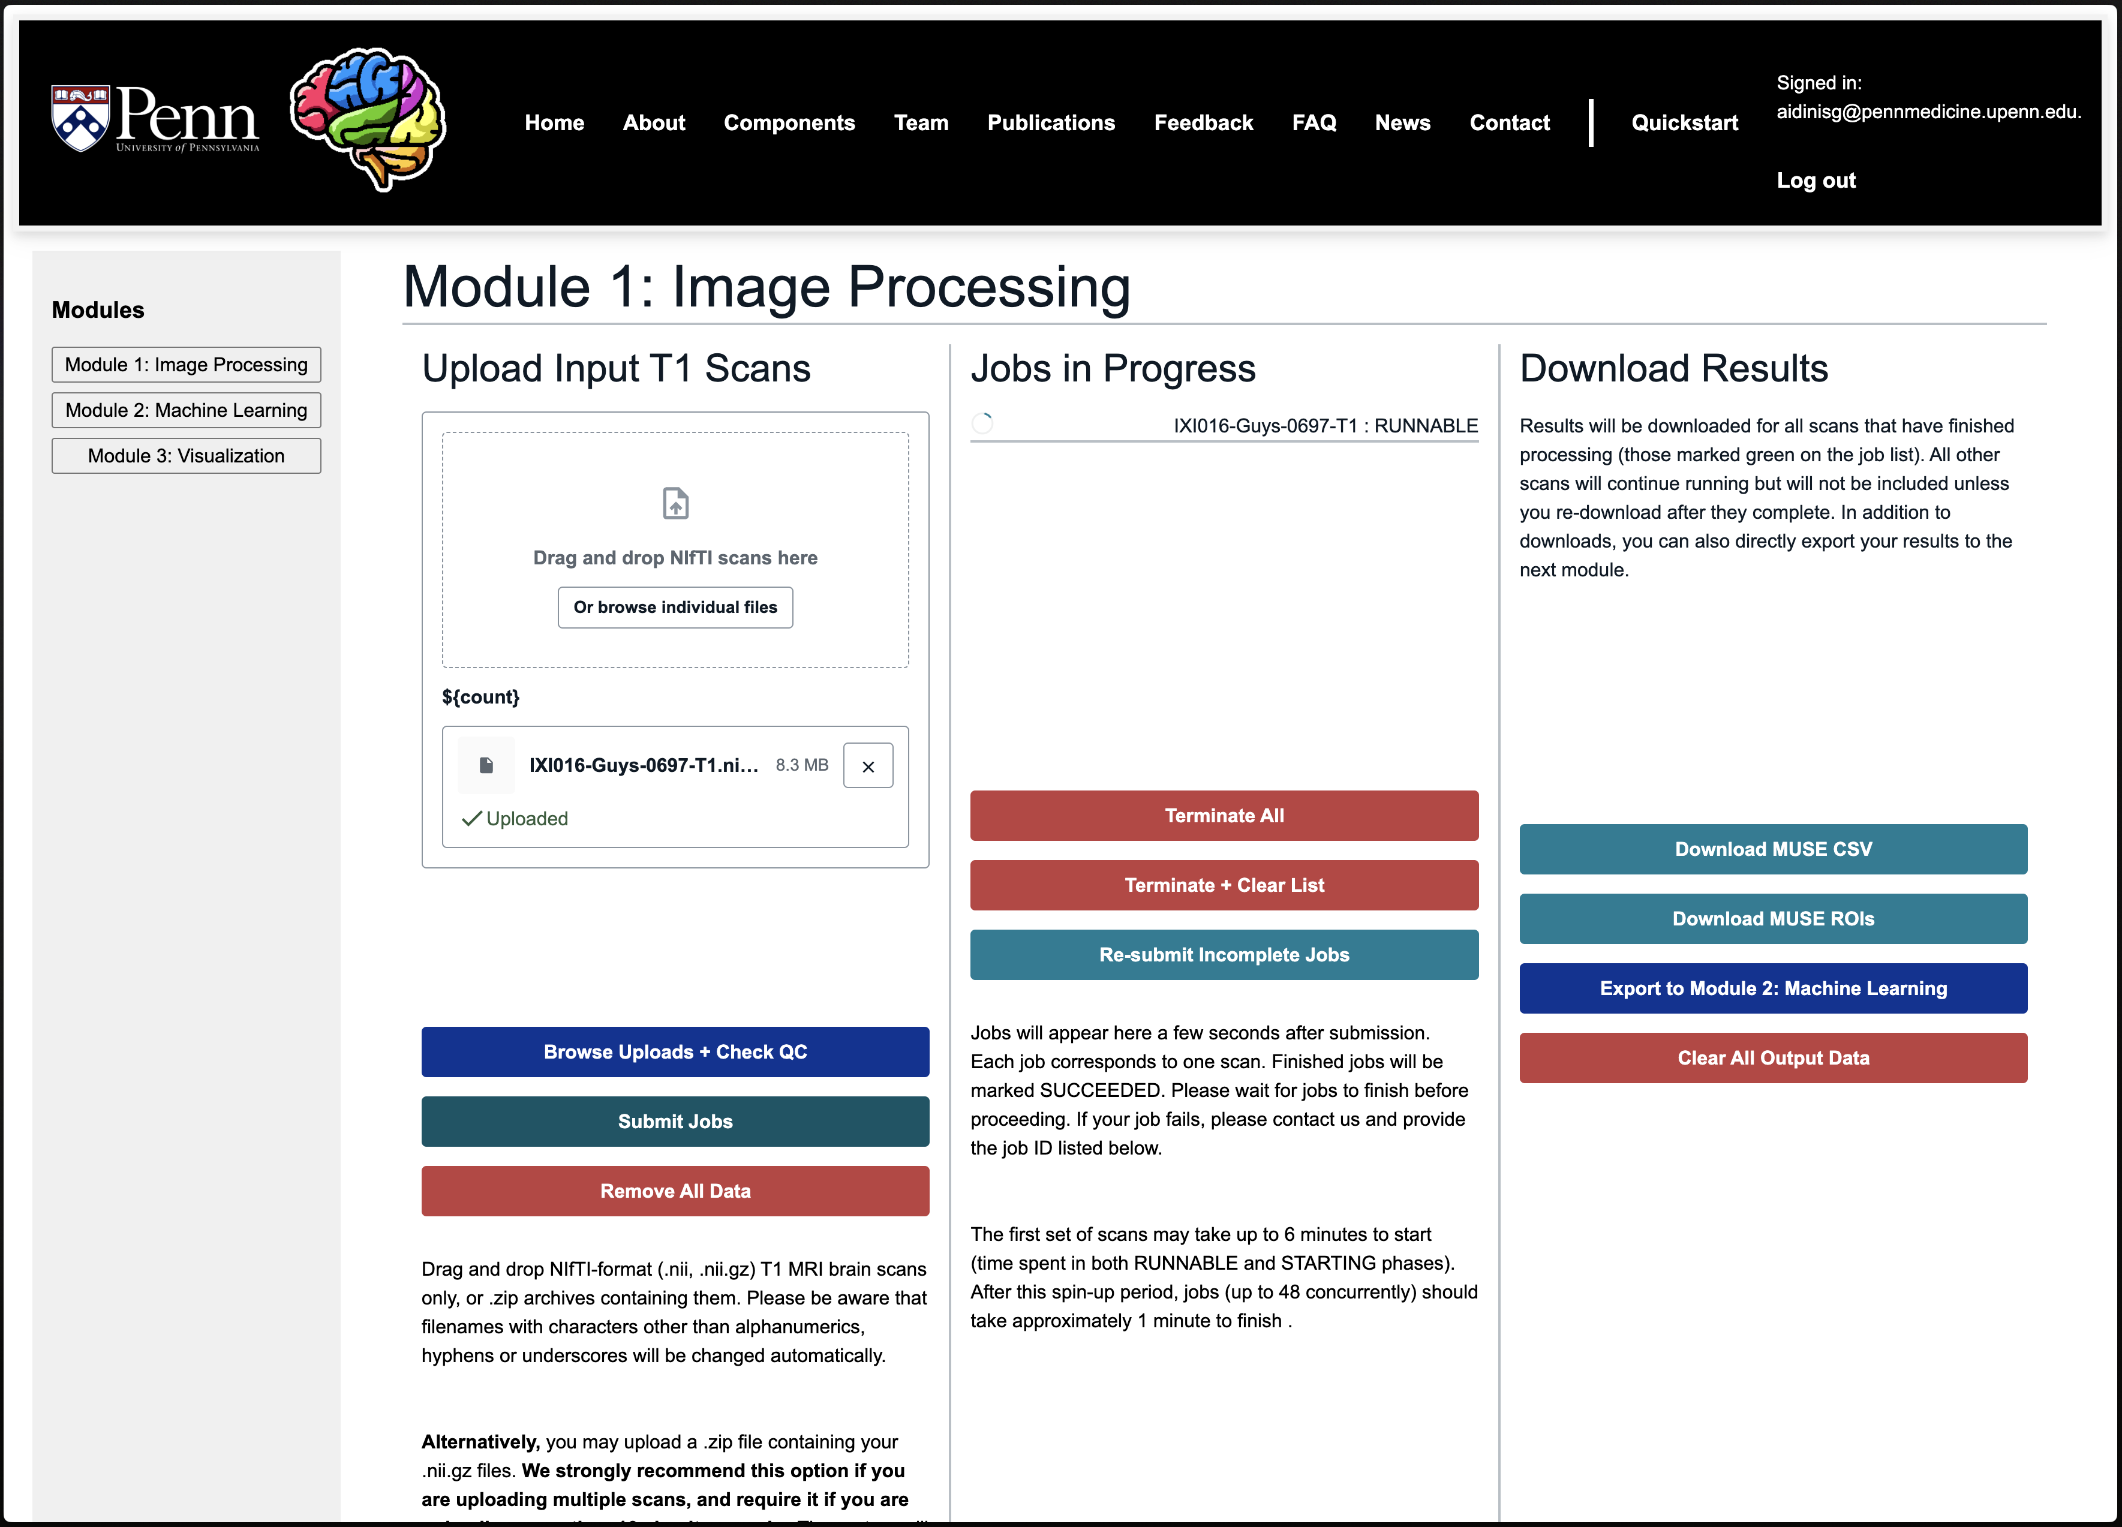
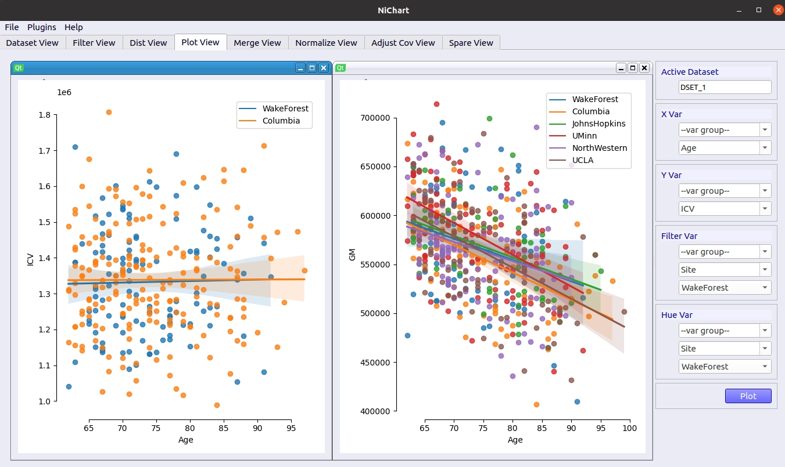
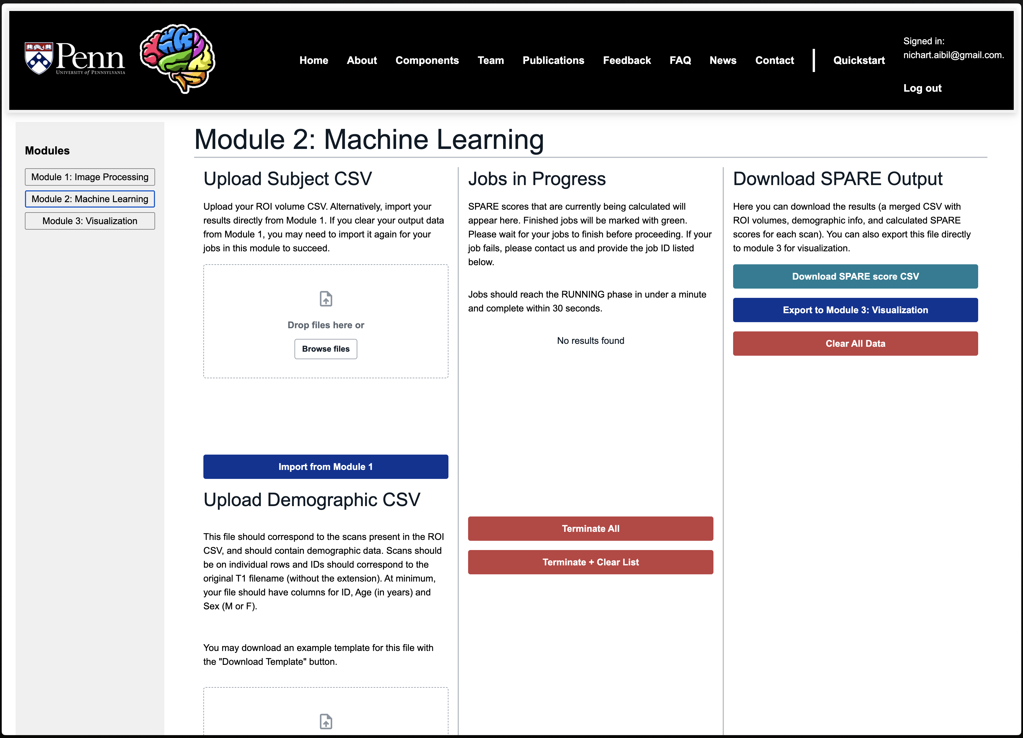
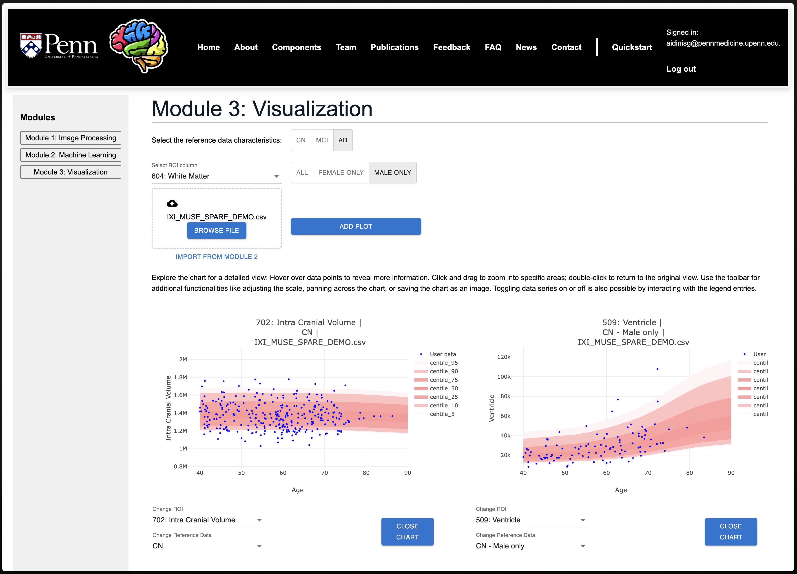
Visualization
PyQT based tool for data visualization:
JavaScript based client-side tool for data visualization on the web:
1. Image Processing
PLACEHOLDER
2. Machine Learning
PLACEHOLDER
3. Visualization

